Slide 1
LinkedFin
beyond traditional finance
https://github.com/LinkedFin
LinkedEconomy team
Μιχάλης Βαφόπουλος
Ιωάννης Aναγνωστόπουλος
Μάκης Ραζής
Γιώργος Βαφειάδης
Λευτέρης Γαλανός
Creative Commons License
This work is licensed under a Creative Commons Attribution-Share Alike 4.0 International License.

Slide 2
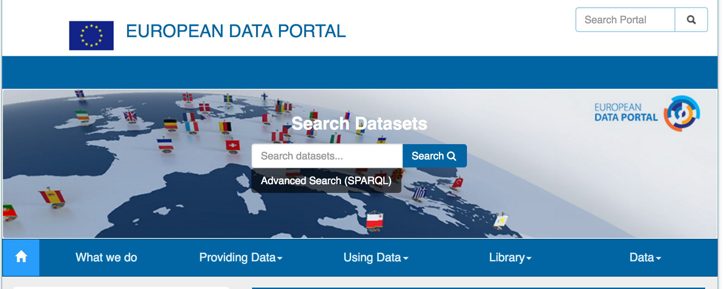
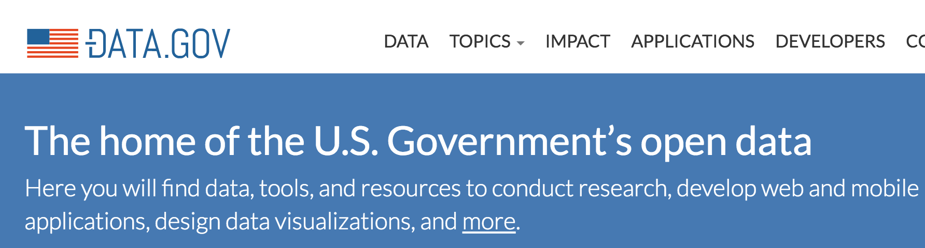
Open economic data
Unprecedented
Disaggregated
Rich content
Big, raw and diverse
e.g. detailed public spending

Slide 3
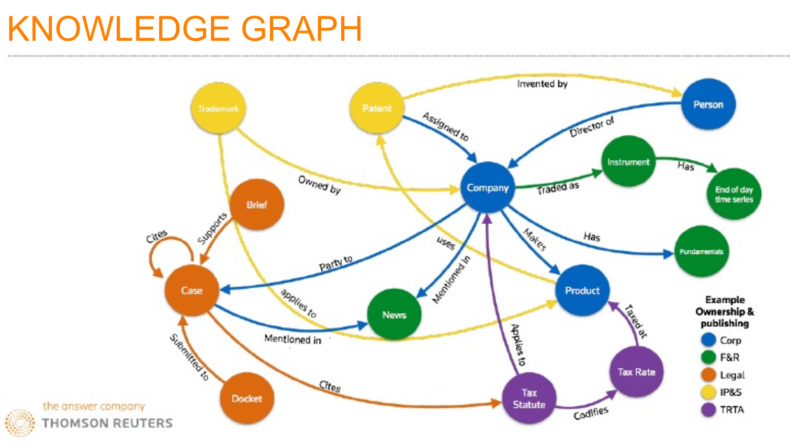
How to benefit
Integrate into BIs and decision-making process

Slide 4
LinkedFin: how it works
harvest open data
validate
analyse
present
Integrate with BI
Extending business evaluation by interlinking economic and social open data.

Slide 5
Open data sources
Public procurement:
Diavgeia & LinkedEconomy.org
Financial Transparency System EU Australian Government data portal
Social media
InfluenceTracker SPARQL endpoint
Corporate information
Greek Gazette (FEK)
NBG API (incomplete)
Dbpedia (incomplete)

Slide 6
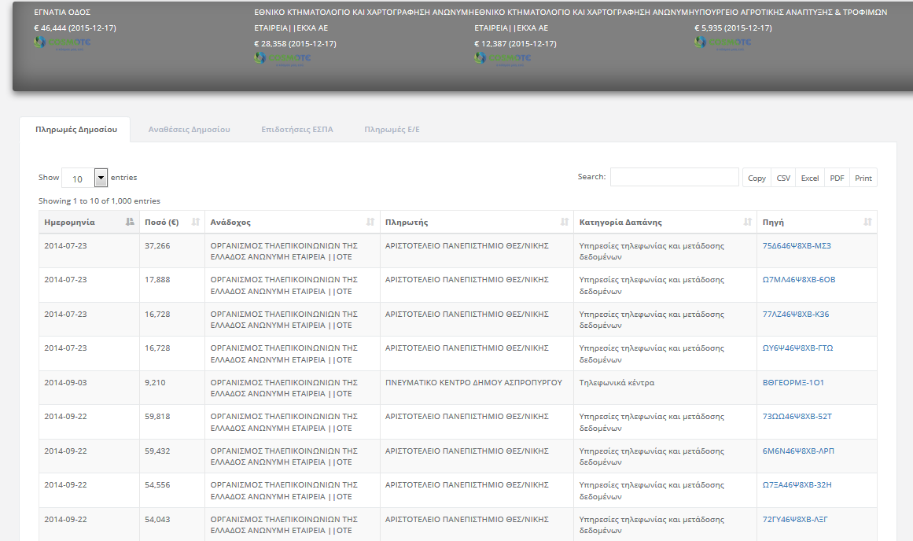
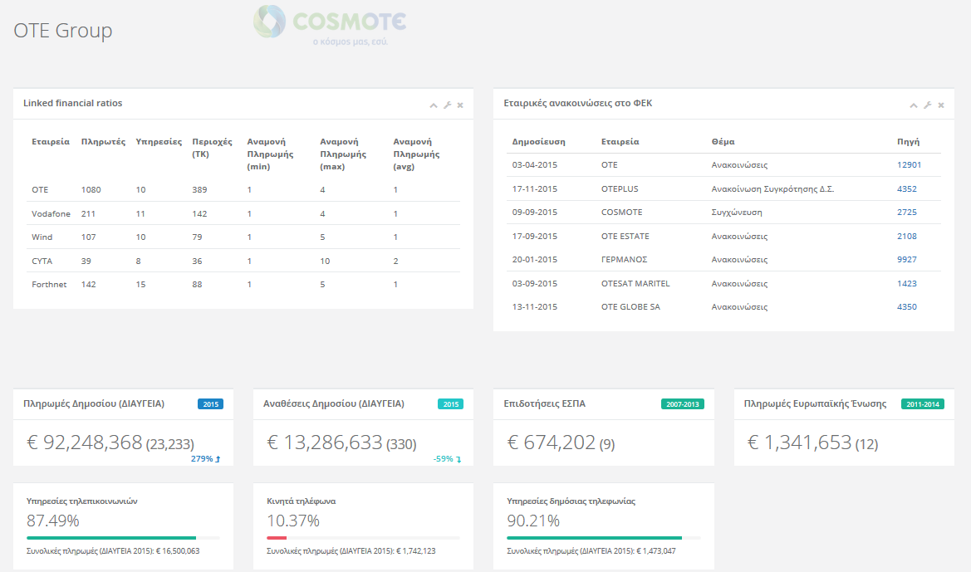
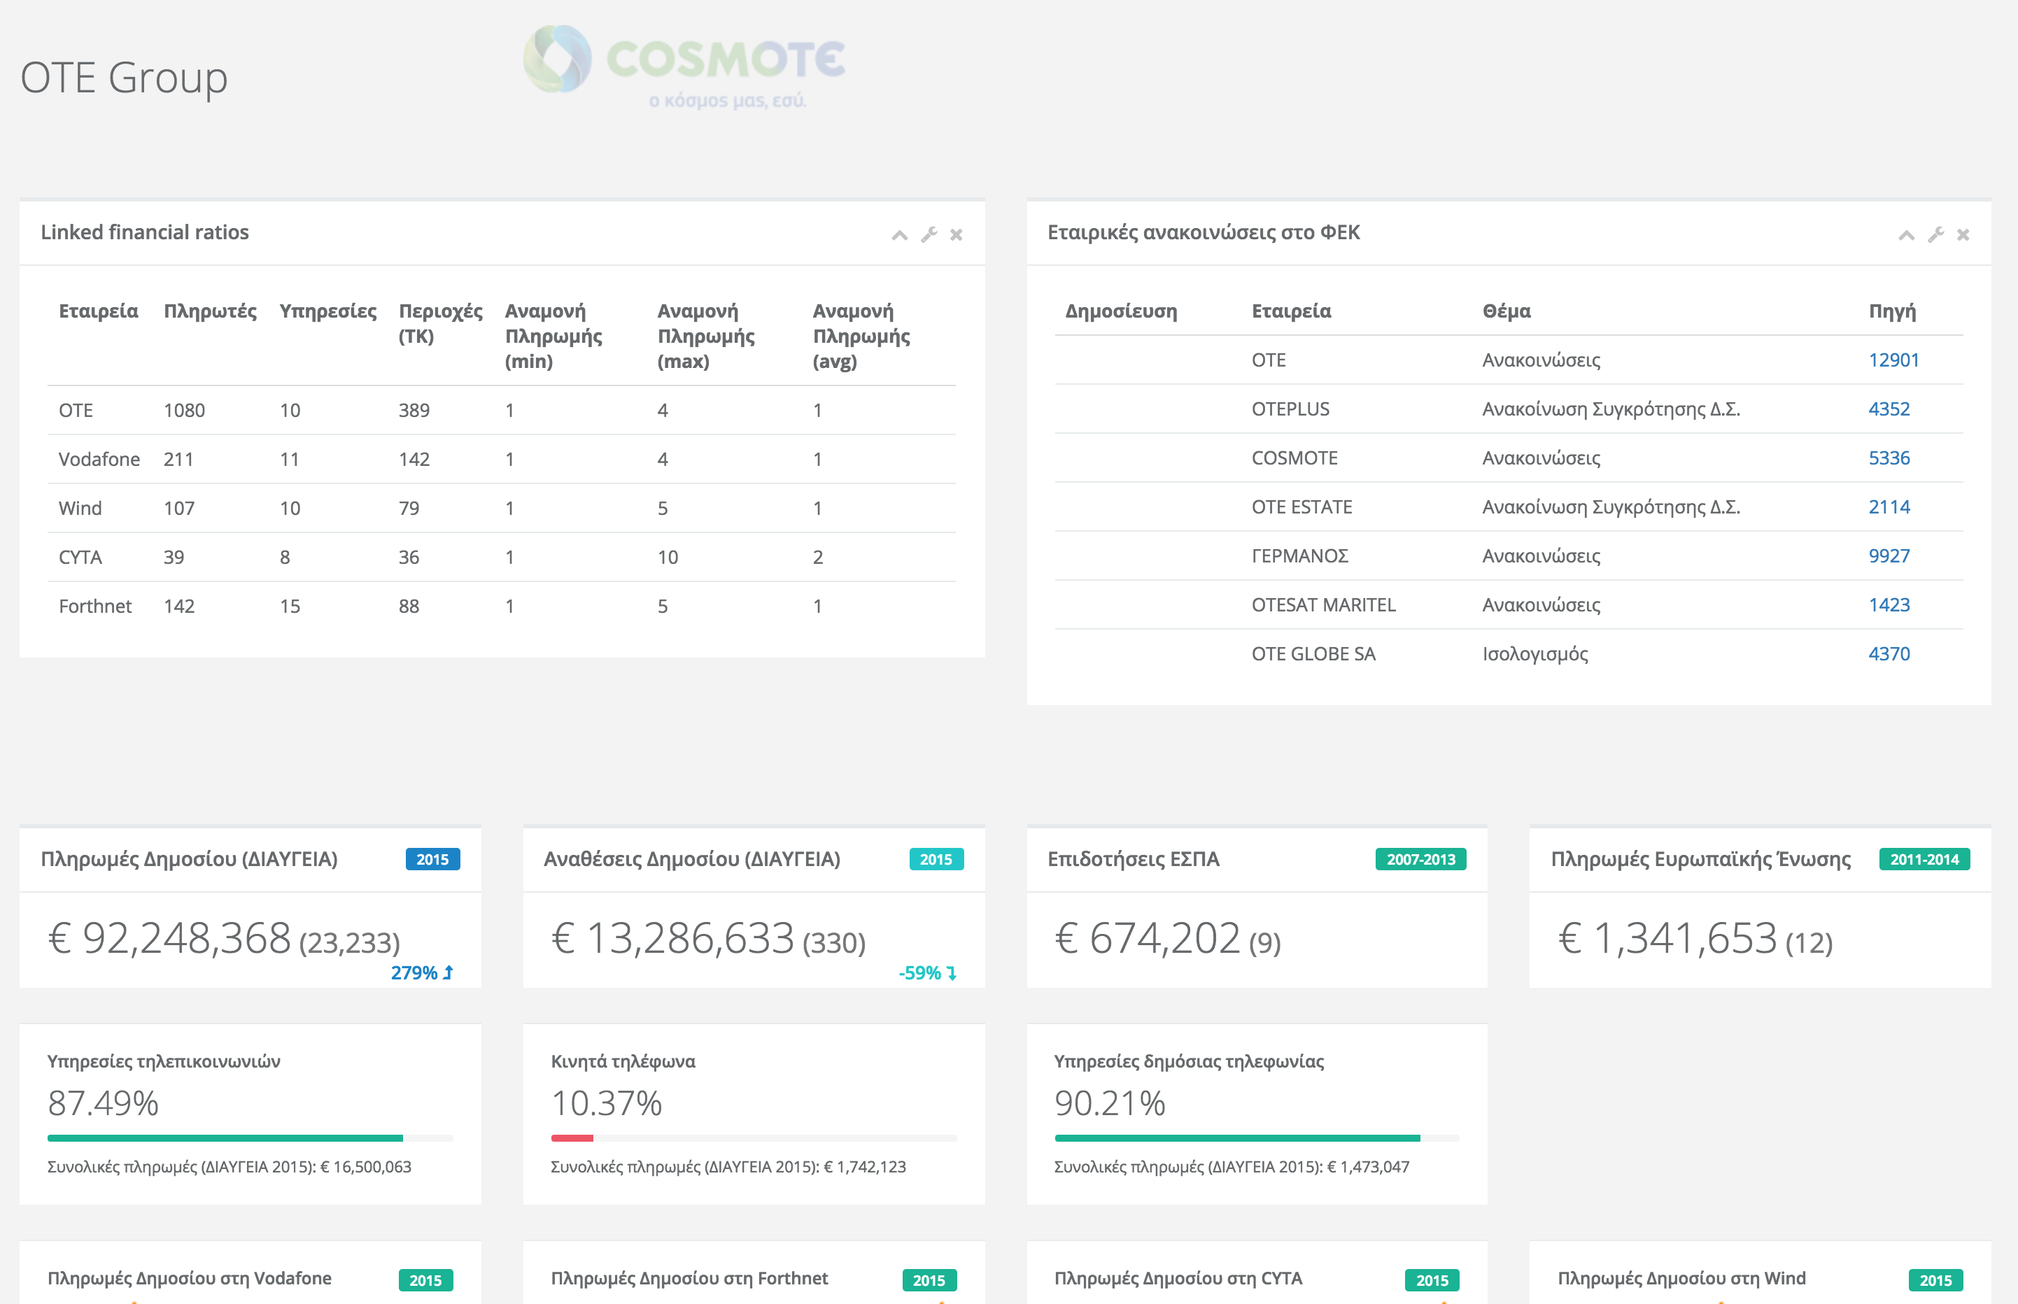
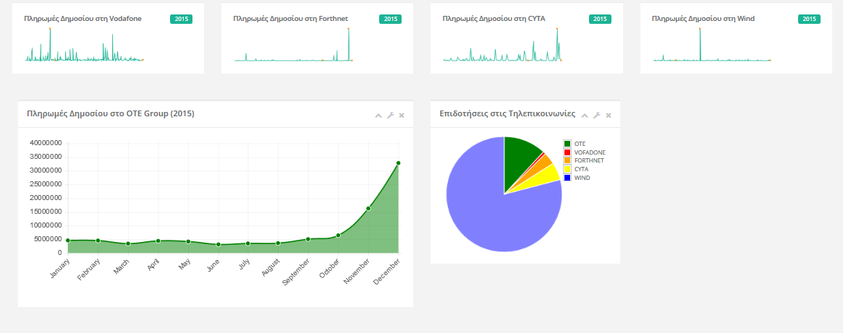
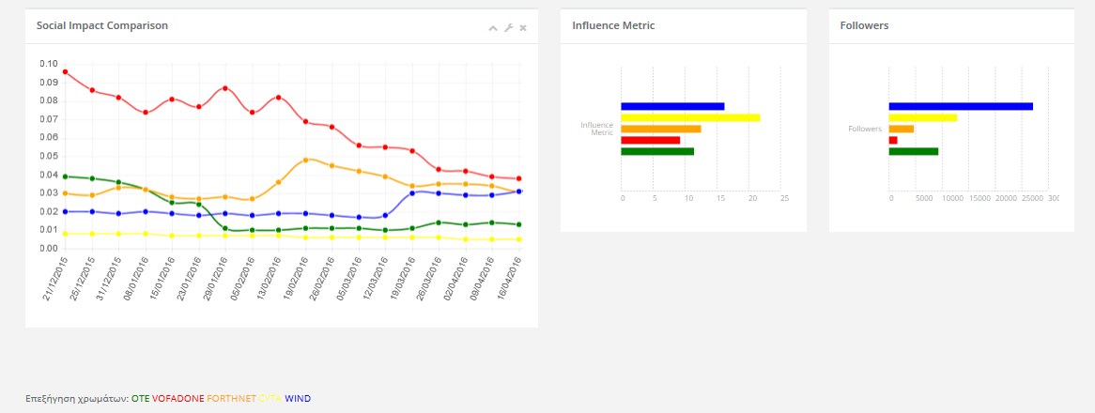
Dashboard

Slide 7
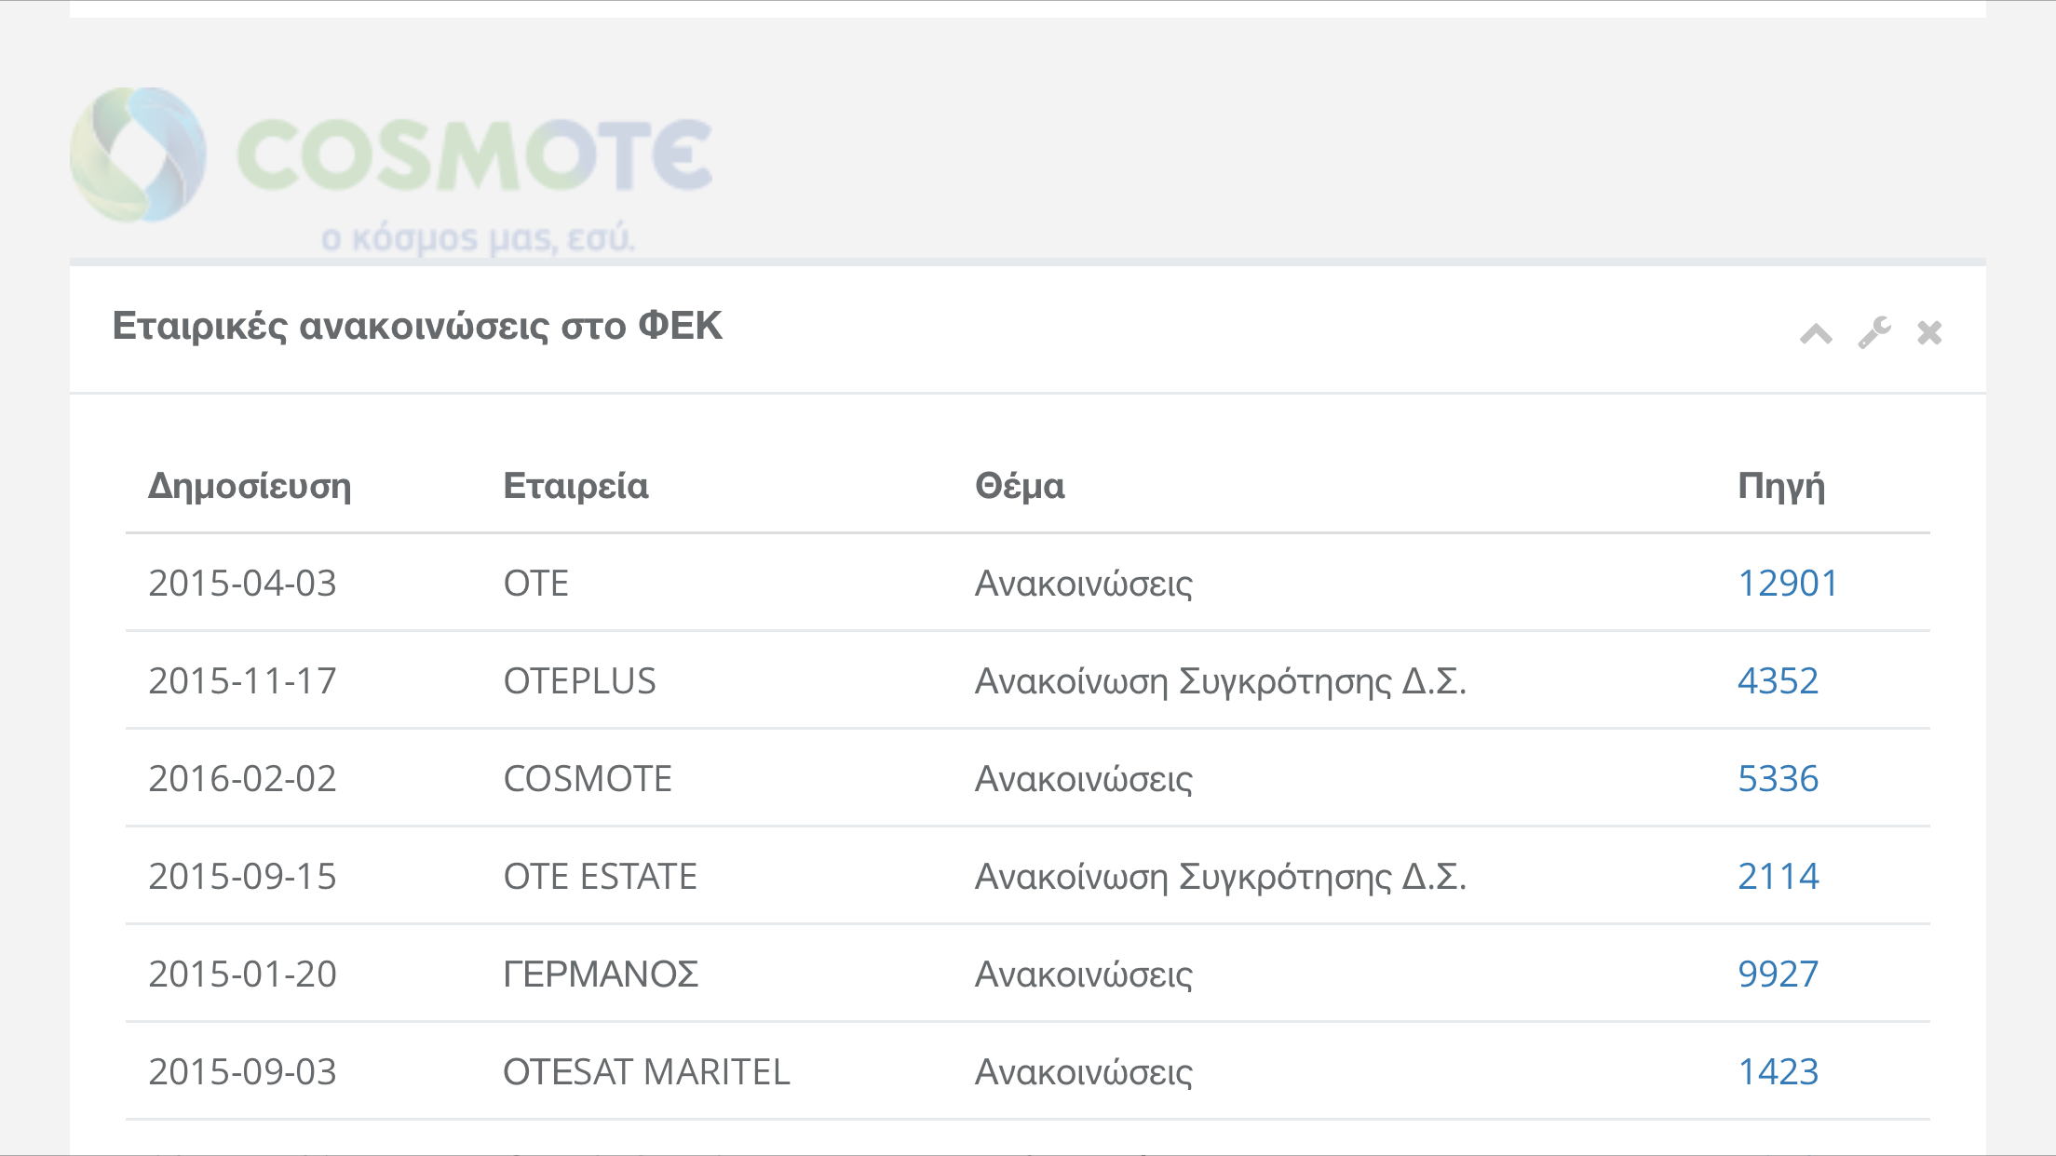
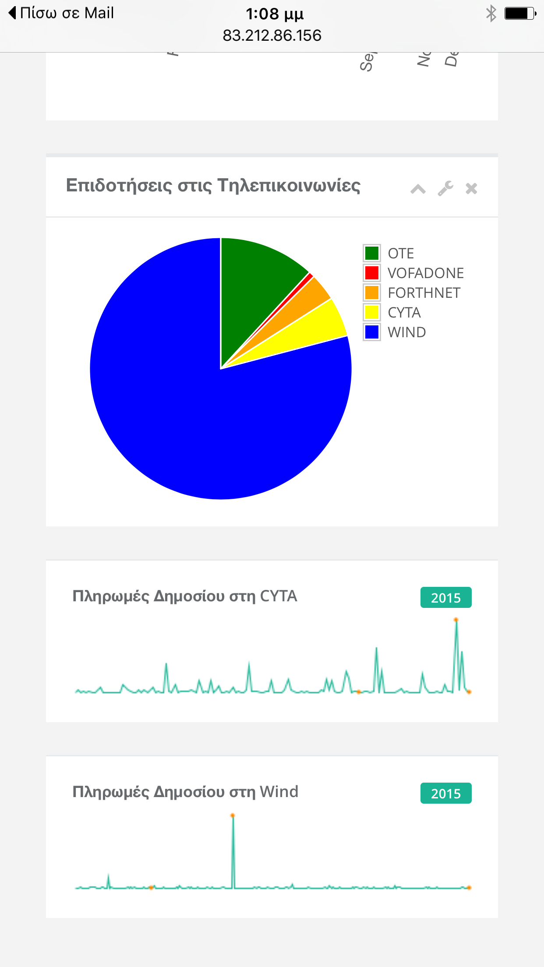
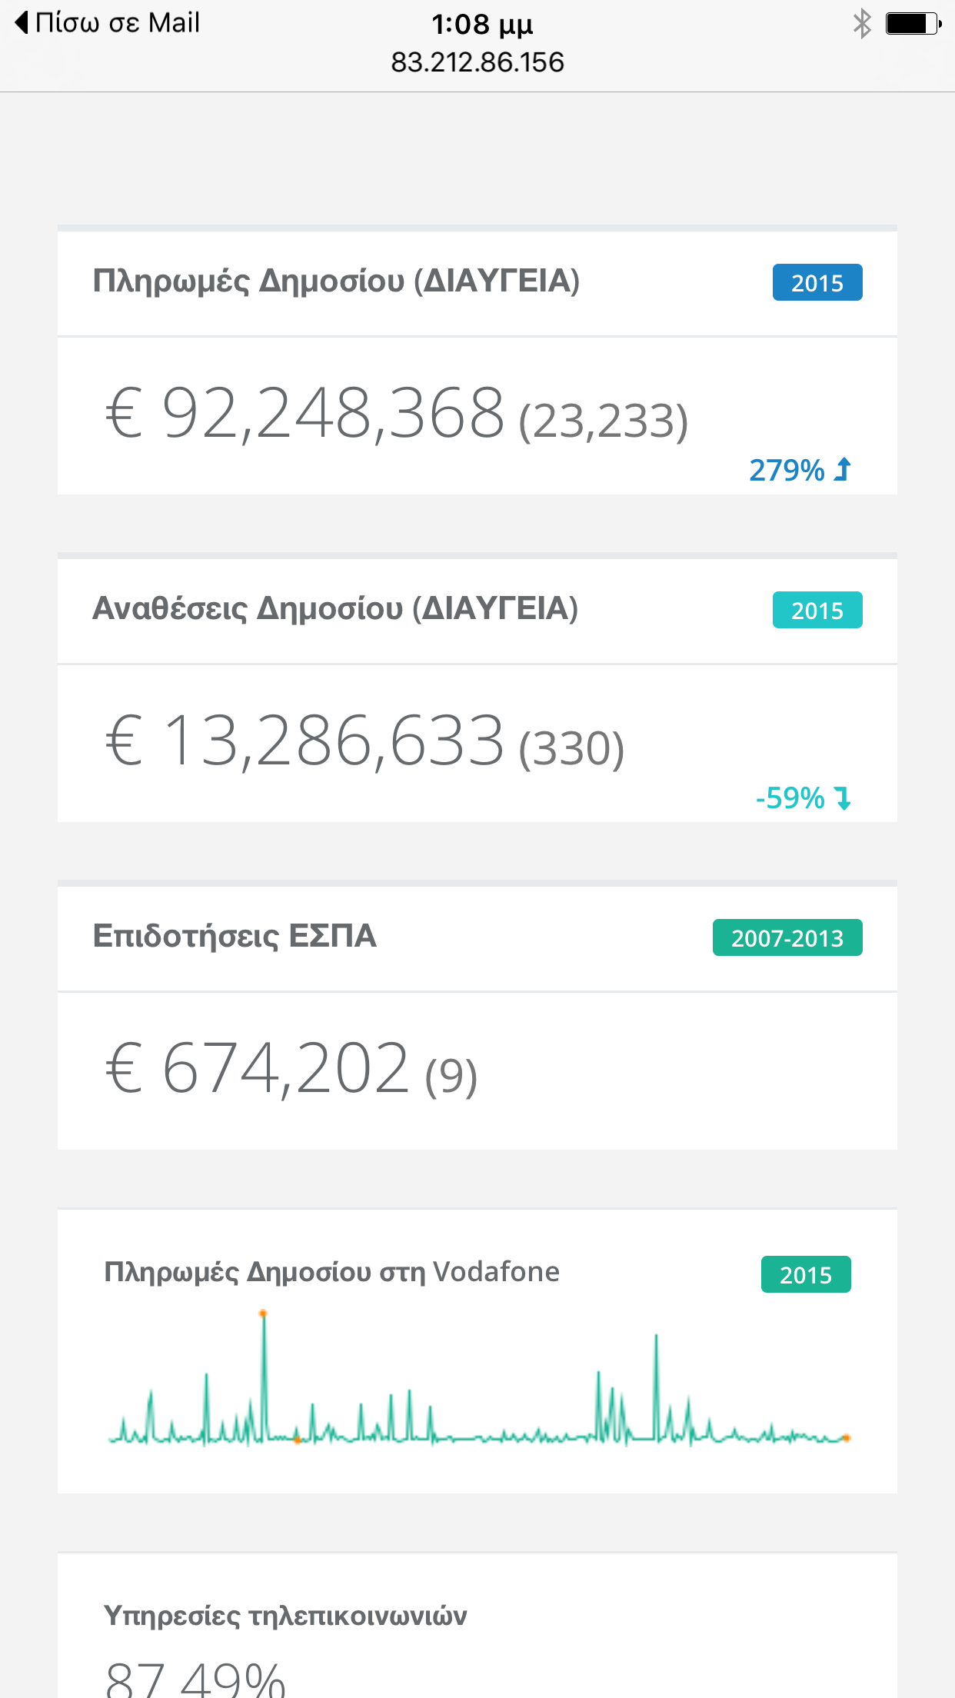
Mobile

Slide 8
INTEGRATION
SPARQL Queries
Data Validations
JSON
Main dashboard views
New financial ratios
…

Slide 9

ΙΝΝΟVATION
Orchestrating social, open & big corporate data for financial analysis
Automated data source validation and integration (from harvesting to distribution)

Slide 10
ΒUSINESS MODEL
Financial analysts
Business evaluation
Credit risk
Wealth management
Models
Basic information:open (comments/crowdsourcing)
Advanced: subscription
Custom: per case/customer (investment funds)

Slide 11
Technologies
OCEANOS/Linux
Java - jena
SPARQL
JSON
Angular
Bootstrap
INSPINIA - Responsive Admin Theme

